Slide 1
PaperVis: Literature Review Made Easy
Jia-kai Chou & Chuan-kai Yang
National Taiwan University of Science and Technology
Computer Graphics & Multimedia Laboratory

Slide 2
How do we review literatures?
Read as many relevant papers as possible.
Search for a specific concept or idea within a large corpus of documents. And read all relevant papers.
Select a paper of interest and read all its citations and references.

Slide 3
What is the problem ?
Too many seemingly related papers to read.
It is easy to get lost after following a few links for searching or cross-referencing.
Prioritizing the reading sequence!!!
Notes:
By starting with the most important/relevant papers,
it significantly helps catching the overall picture of a specific
research field in the early stage.

Slide 4
Goal
Help identifying relevant/important papers quickly.
Defining the relevance/importance among papers.
Node-link graph for better conveying the relationships among papers.
Offer an effective tool to navigate the paper citation network
Interactive.
Visual hints to prevent getting lost.
Notes:
Interactive => not only interactive but also prompt responses
Visual hints to prevent getting lost => preserve the coherence among transitions

Slide 5
3 feature modes
Reference-Citation Mode
Visualize a paper of interest and its associated citation network.
Keyword Mode
Visualize papers with common keyword sets.
Mixed Mode
Combine the above 2 methods.
(Categorize the papers in a paper’s citation network with common keywords. )
Notes:
每個mode會先解釋一下做法，然後帶一個scenario

Slide 6
Reference-Citation Mode
Defining the relationships among papers
Node placement
Preserving the coherence among transitions

Slide 7
Defining the relationships
[Crnovrsanin et al. 2009]
[Song 1998]
[Furnas 1986]
[van Ham and Perer 2009]
[Broder et al. 1997]

Slide 8
Defining the relationships
p_{s}: the selected paper
p_{o}: any other paper
Cite(X): the papers that have referenced the set of papers in X.
Ref (X): the papers that the set of papers in X have referenced.
Relevance => co-reference percentage.

Slide 9
Defining the relationships
Level =>reference/citation relationship with respect to p_{s}.
p_{s}’s direct references=>Node_{l}(p_{o} ,p_{s})=1, p_{o} ∈ P1
p_{s}’s direct citations=>Node_{l}(p_{o} ,p_{s})=2, p_{o} ∈ P2
References of P1 and P2=>Node_{l}(p_{o} ,p_{s})=3, p_{o} ∈ P3
Papers that have referenced P1 and P2=>Node_{l}(p_{o} ,p_{s})=4, p_{o} ∈ P4
# Note that a paper can only be set to a minimum level.
Importance => percentage of being referenced by p_{s}’s direct citations/references.
…
Notes:
舉例說明一篇paper只能被設定一個最小的level
For example, two papers (say paper A and B) are referenced by p_{sel} , so the levels of paper A and B are both 1. If paper A
is also referenced by paper B, then the level of paper A can be 3 and the level of paper B can be 4. In this situation, the
levels of paper A and paper B are assigned to be 1.

Slide 10
Defining the relationships
Mapping the values of relevance, importance and level to the attributes of a node-link graph.
Importance => the size of a node.
Level => the color of a node.
Relevance => the distance between 2 nodes. (Node_{r} = 1 – Node_{r})
p_{s}
Node_{r}=0.3
Node_{r}=0.7
p_{o}
Node_{l}=2
Node_{imp}=0.4
p_{o}
Node_{l}=1
Node_{imp}=0.9
Notes:
因為關係越強(數字越大)，希望距離擺得越近，所以Node_{r} = 1 – Node_{r}
Furthermore, to prevent nodes from disappearing and sticking with the selected node, the value of relevance is normalized into 0.1~1, and importance is normalized into 0.3 ~1

Slide 11
Node placement
Force-Directed Placement
Self-Organizing Maps
GEM algorithm
Distances among nodes become less meaningful

Slide 12
Node placement
Optimization problem
Quadratically Constrained Quadratic Program ➔ NP-hard problem

Slide 13
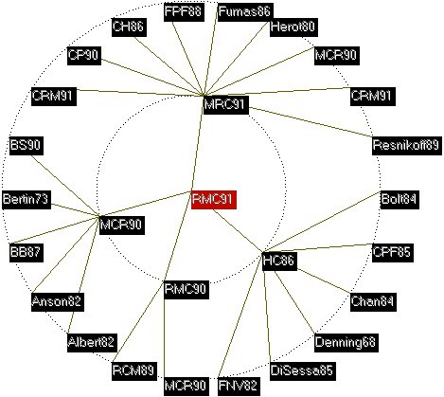
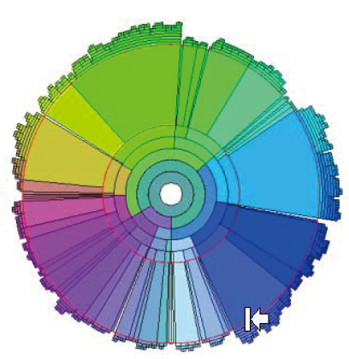
Node placement
Radial Space Filling (RSF)
Bullseye view
[Yang et al. 2002]
[Cheng-Zen Yang and Chiun-How Kao 1999]
Notes:
RSF利用不同半徑的同心圓來呈現不同階層的資料，且在各同心圓或扇形區域都可自由調整大小以符合區域內資料的數量或重要性。Bullseye view則是將node放在不同半徑的同心圓上，表示node之間的階層關係。兩者都具有節省所使用的空間的效果。
我們的方法=>除節省使用空間外，還希望保留paper node之間的關聯，然而，paper之間的關係並不一定是階層式的，所以必須做一些調整。Ex: 同一個node重覆出現的問題。
the citation network is not purely hierarchical. If we use this kind of algorithm to place the nodes, the problem of duplicated nodes could happen, that is, the same node may appear more than once. Our goal is to spatially arrange the paper nodes, relative to the central node, so that nodes would not collide with each other while the distances among them respecting their corresponding relevance values.

Slide 14
Node placement
A simplified solution
only concerning the relevance (distances) between the selected paper and any of the other papers.

Slide 15
Sorted sequence | 1 | 2 | 3 | 4 | 5 | 6 | 7 | 8 | 9 | 10 | 11 | 12 | 13 | 14 | 15
relevance | 0.45 | 0.63 | 0.66 | 0.81 | 0.81 | 0.84 | 0.87 | 0.91 | 0.91 | 0.93 | 1 | 1 | 1 | 1 | 1
Checking relevance value:0.1~0.2
Checking relevance value:0.2~0.3
Checking relevance value:0.3~0.4
Checking relevance value:0.4~0.5
Checking relevance value:0.5~0.6
Checking relevance value:0.6~0.7
Checking relevance value:0.7~0.8
Checking relevance value:0.8~0.9
Checking relevance value:0.9~1
p_{s}

Slide 16
Dealing with collisions
??
p_{s}

Slide 17
Node placement
More complicated node placement scheme
maintaining the relationships among all paper nodes.

Slide 18
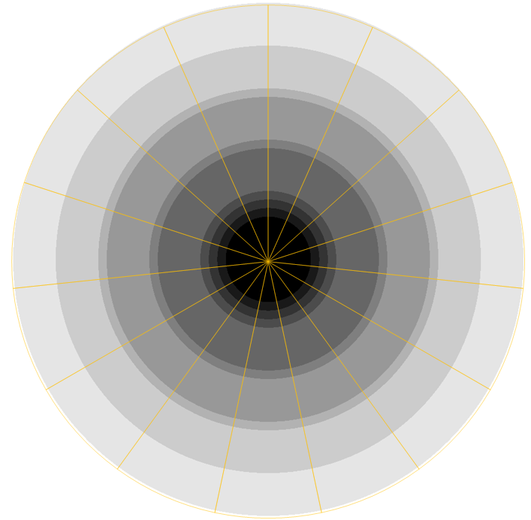
Sorted sequence | 1 | 2 | 3 | 4 | 5 | 6 | 7 | 8 | 9 | 10 | 11 | 12 | 13 | 14 | 15
relevance | 0.45 | 0.63 | 0.66 | 0.81 | 0.81 | 0.84 | 0.87 | 0.91 | 0.91 | 0.93 | 1 | 1 | 1 | 1 | 1
Elliptic sequence | 13 | 10 | 9 | 8 | 5 | 6 | 4 | 12 | 11 | 14 | 1 | 15 | 7 | 2 | 3
11
12
13
14
10
15
9
p_{s}
1
8
2
7
3
6
4
5

Slide 19
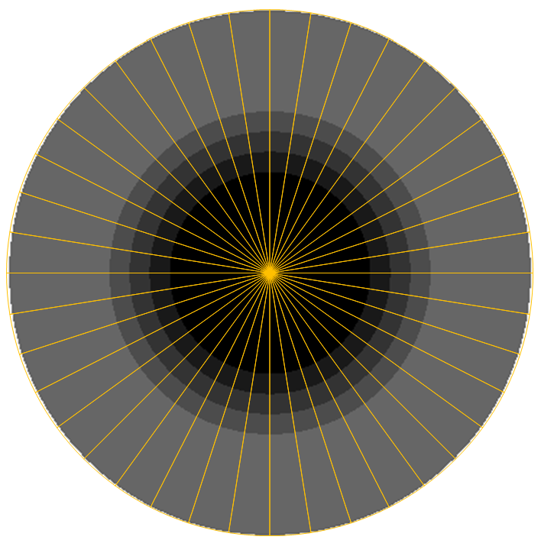
Dealing with collisions
collision!!
p_{s}

Slide 20
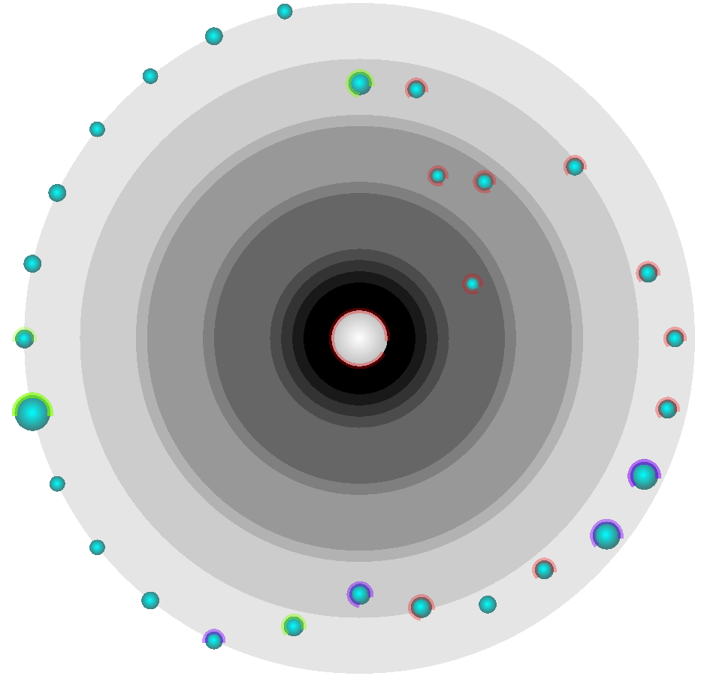
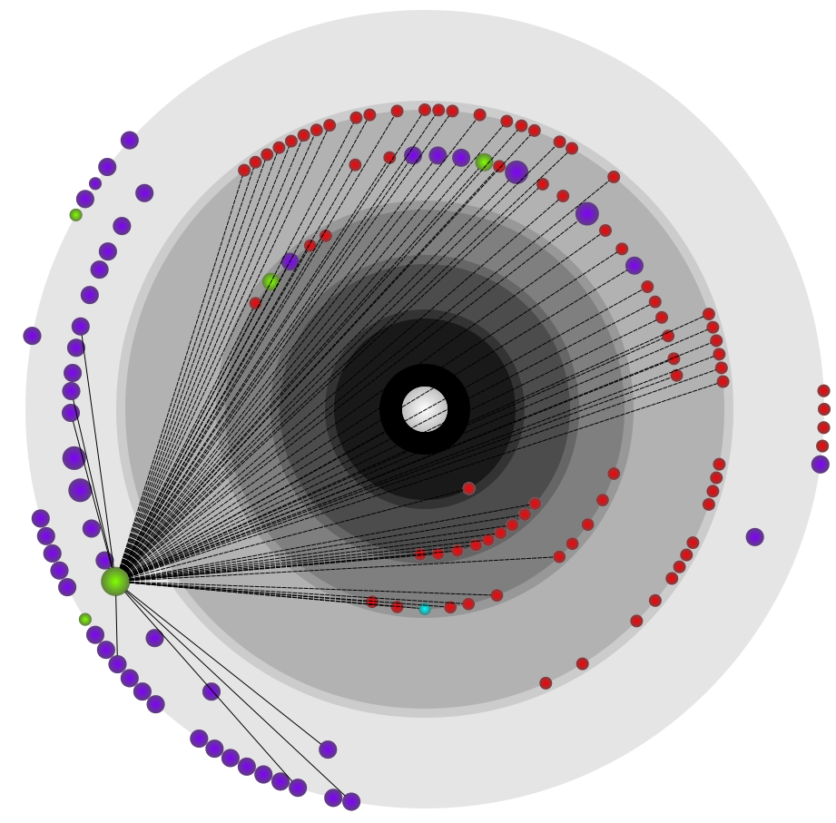
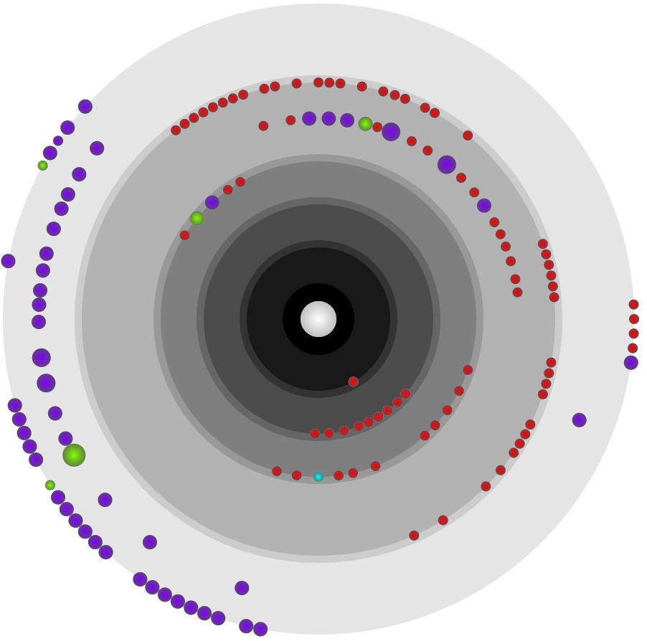
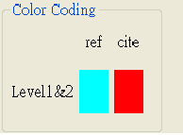
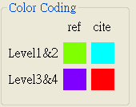
Possible scenario
Node with the largest size
Nodes with high relevance among each other
Notes:
見paper中的case study 1

Slide 21
Keyword Mode
Using keywords as a category to cluster papers into groups.
Radial Space Filling (RSF) layout
Preserving the maximum number of common keywords among papers.
Notes:
因為是(hierarchical structure)樹狀結構，所以直接用rsf layout

Slide 22
Keyword Mode
Paper | Keywords included
A | visualization, data, mapping, 3D
B | visualization, WWW, mapping, 3D
C | visualization, data, tree, graph
D | visualization, data, WWW, design
Keyword | Paper count
data | 3
mapping | 2
3D | 2
WWW | 2
tree | 1
graph | 1
design | 1
Keyword | Paper count
data | 3
mapping | 2
3D | 2
WWW | 2
tree | 1
graph | 1
design | 1
visualization (A,B,C,D)
data
(A,C,D)
3D (A,B)
mapping (A,B)
WWW
(B,D)
visualization (A,B,C,D)
visualization (A,B,C,D)
data
(A,C,D)
3D (A,B)
mapping (A,B)
3D (A,B)
WWW
(B,D)
mapping (A,B)
Notes:
兩種threshold 模式：
1、每個節點中至少須包含N篇PAPER
2、每個父節點至多往下生出前N個PAPER數量最多的子節點
Example中假設設定的threshold 為每個node至少要包含兩篇paper

Slide 23
Comparison
Paper | Keywords included
A | visualization, data, mapping, 3D
B | visualization, WWW, mapping, 3D
C | visualization, data, tree, graph
D | visualization, data, WWW, design
visualization (A,B,C,D)
data
(A,C,D)
3D (B)
mapping (B)
WWW (B)
mapping (A)
tree (C)
WWW (D)
3D (A)
graph (C)
design (D)
visualization (A,B,C,D)
data
(A,C,D)
3D (A,B)
mapping (A,B)
3D (A,B)
WWW
(B,D)
mapping (A,B)
[Zhang et al 2009] FP-tree
Our method
Notes:
It could be easily observed that paper A and B have 3 keywords in common. In PaperVis, we preserve the maximum
number of common keywords between 2 papers, so that papers with similar set of keywords would be grouped into the
same node. However, the algorithm in FP-tree split paper A and B into 2 separated clusters in the node splitting process at first level.
Our method, exhaustively searches for all possible common keyword sets if no threshold is adopted, thus potentially
yielding unnecessary and meaningless results. As a consequence, a proper parameter configuration is needed.

Slide 24
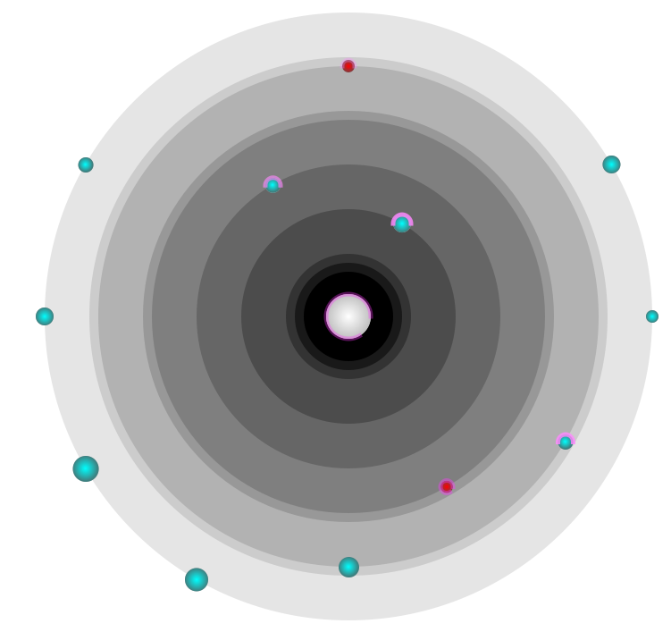
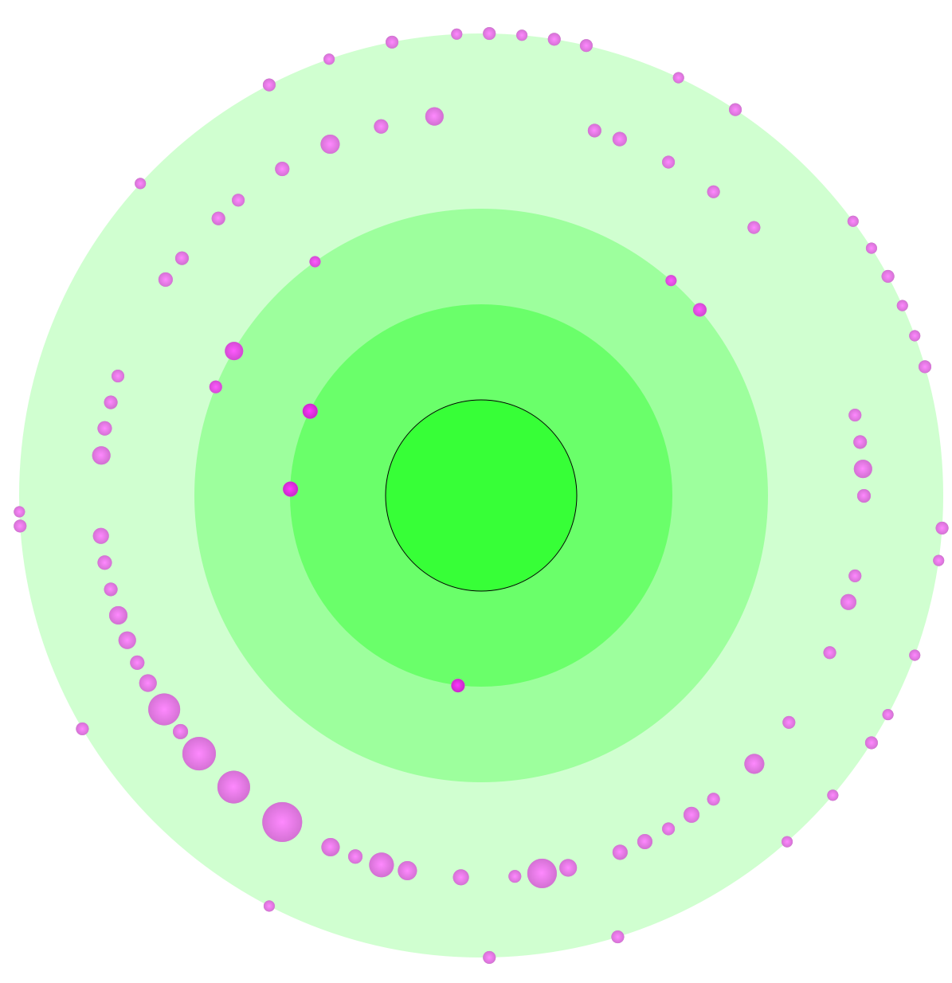
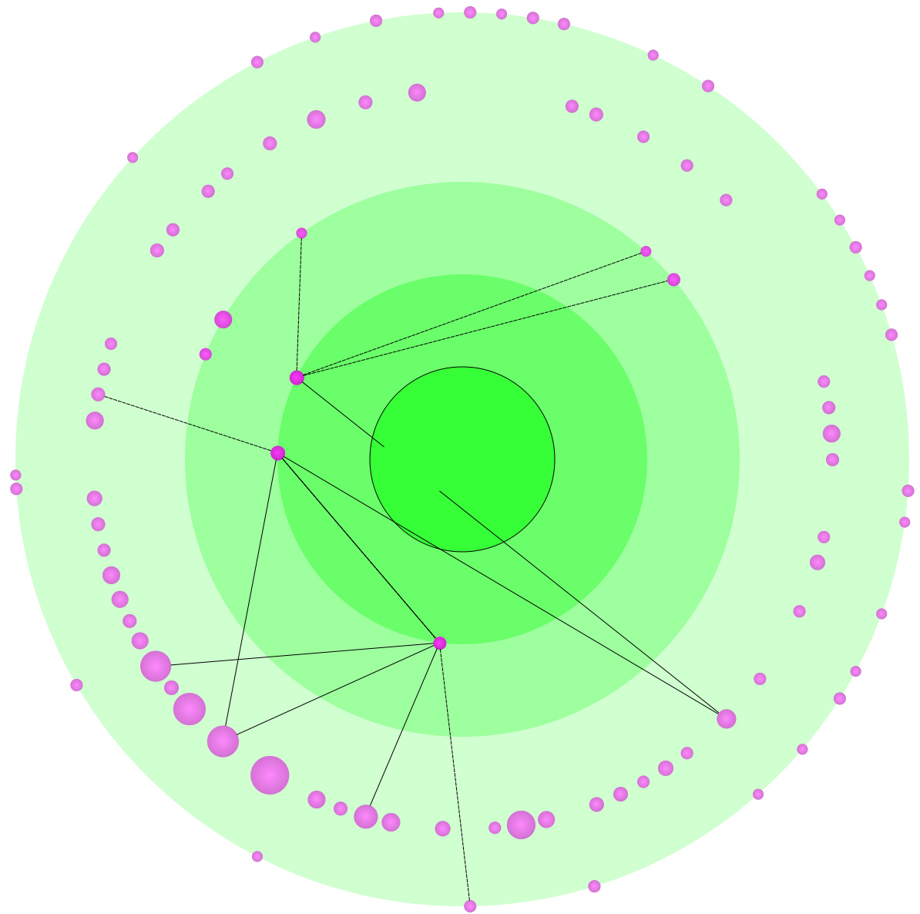
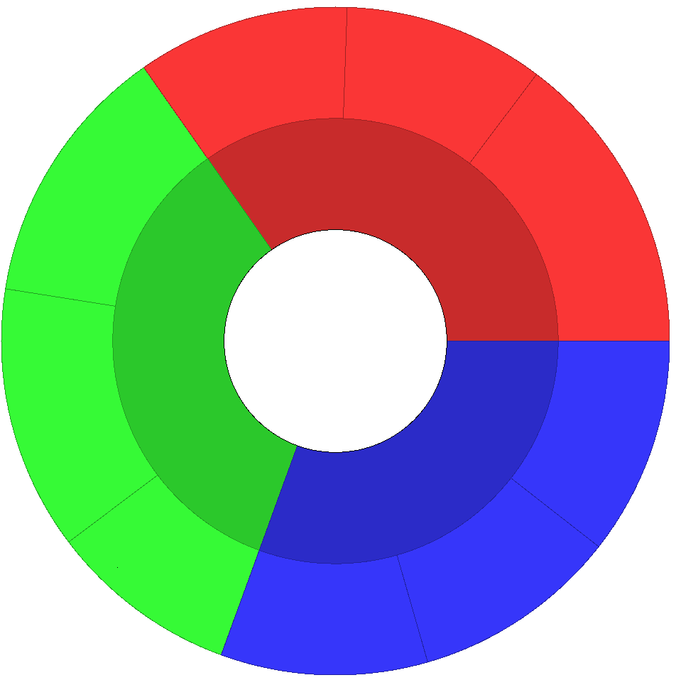
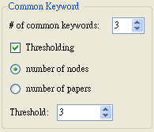
Possible scenario
data visualization
(2)
information systems
(2)
hypertext
(3)
information retrieval
(8)
text visualization
(3)
information visualization (89)
World Wide Web (8)
hypertext (3)
information visualization (89)
World Wide Web (8)
hypertext (3)
information visualization
(89)
information visualization (89)
World Wide Web (8)
hypertext (3)
World Wide Web
(8)
usability
(3)
navigation
(2)
data visualization
(7)
multiscale interfaces
(2)
information systems
(2)
information retrieval
(2)
Notes:
見paper中case study2
其中最後一個圖(在paper中沒有)是要講說點選其中一個node或轉成 reference-citation mode，在refocused view中，除了觀察selected node與其citation network的關係外，node boundary還保留了，哪些點跟selected node有相同的keyword set。且那些有相同keyword set的paper也都與selected node有較高的relevance。

Slide 25
Mixed Mode
Combining Reference-Citation Mode and Keyword Mode together.
The selected paper should have at least 1 keyword.
See how the papers in a citation network have keywords in common.
Notes:
The user select a paper of interest. Then the system loads the papers in its citation network, and group the loaded papers by common keyword sets.

Slide 26
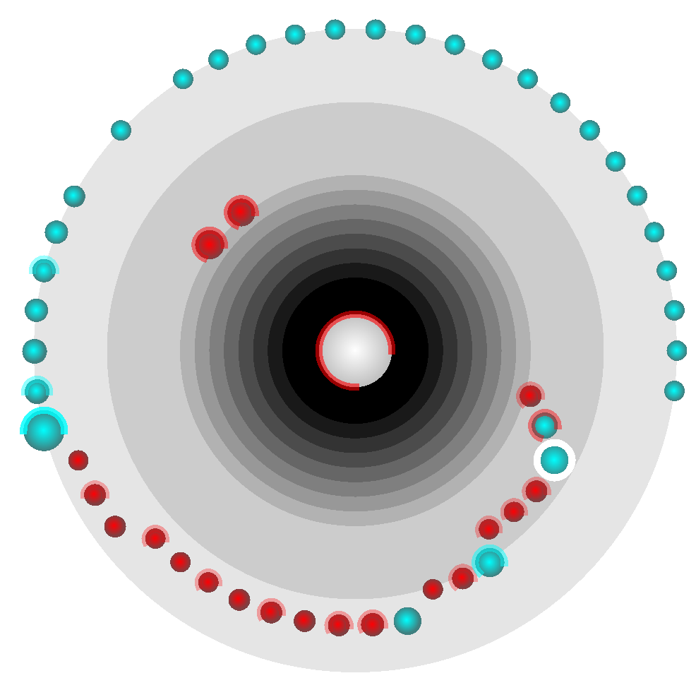
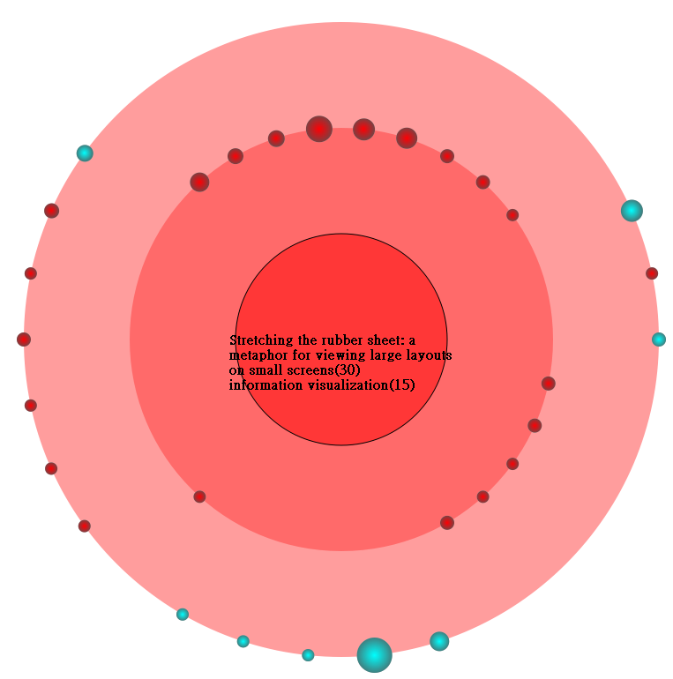
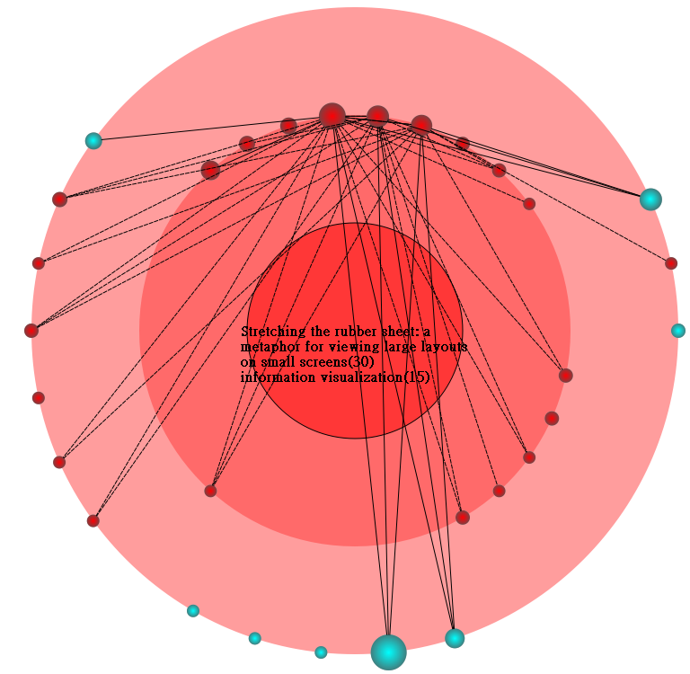
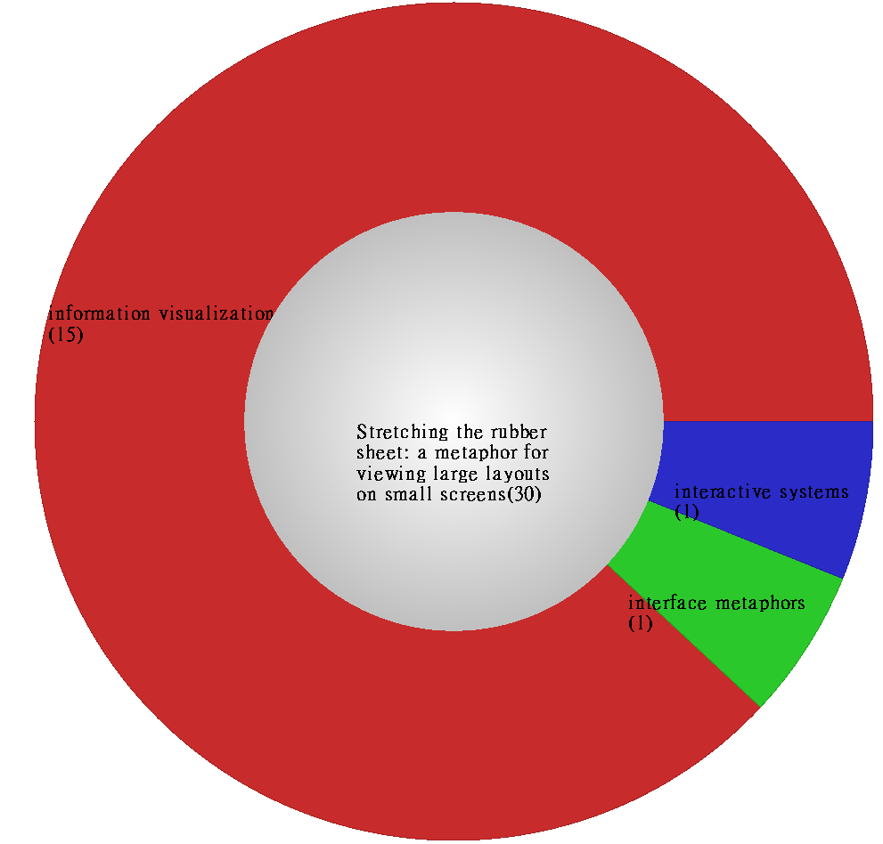
Possible scenario
Nodes with important values and highly correlate to each other

Slide 27
Discussion
The computation of importance and relevance could be changed to fit different applications.
Performance issues
the time to calculate the elliptic ordering in Citation-Reference Mode.
Notes:
The elliptic sort algorithm iteratively generates the sequences of N samples from the symmetric correlation matrix until convergence. In each iteration,
it takes O(N²) to compute the correlation coefficients among N samples. The algorithm stops if the derived sequences remain the same in 2 consecutive iterations.

Slide 28
Future works
Multiple focus nodes.
Broadening the coverage of the analysis.
Clustering the common keyword sets with semantic similarities.

Slide 29
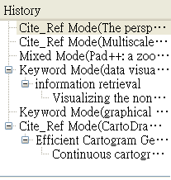
Conclusions
Radial Space Filling + Bullseye View
efficiently utilizing the screen space.
Node sizes, colors and distances among them.
demonstrating the relationships.
Visual cues + history-review tree
maintaining the before-after correspondence during transitions.

Slide 30
Thank you for your attention!

